Slide 1
ASSIGNMENT
Name: VINAY KUMAR PARASHARA BATTER
Problem Statement
Bank of Corporate conducted a telemarketing campaign for one of its financial products,
‘Term deposits’, to build a long-term relationship with the existing customers. Your goal is to identify the target customers for the term deposits from the pool of the bank’s existing customers. You should also capture the key driving factors (or driver variables) behind the successful conversion of a customer, i.e., the customer opening a term deposit account with the bank.
Assignment Objective
To identify the target customers and the driving factors behind a successful customer
conversion for future marketing campaigns.

Slide 2
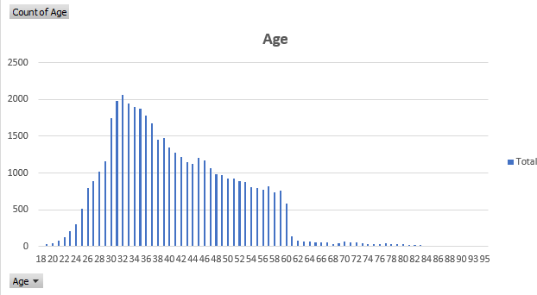
PART I : Univariate Analysis
Variable under consideration: Age
Majority of the Customers lies in the range of 23-60 years we can also observe there is a decrease in count in age after 60 years.

Slide 3
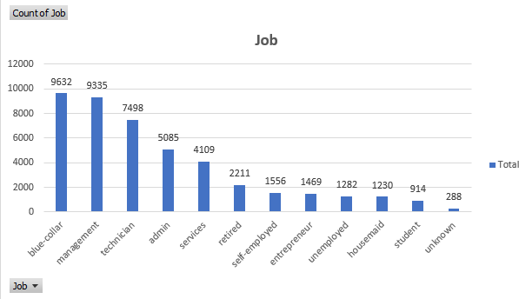
PART I : Univariate Analysis
Variable under consideration: Job
Majority of the Customers from Blue-Collar and Management job categories.

Slide 4
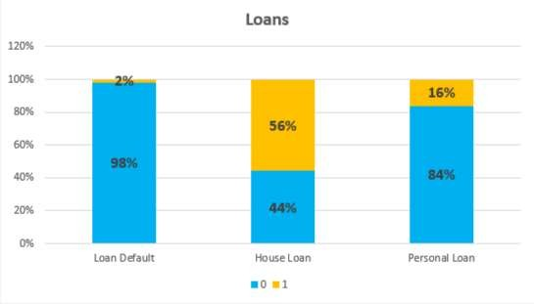
PART I : Univariate Analysis
Variable under consideration: Loans
Customers Who defaulted Loan are less i.e. 2%
Customers Who took House Loan are More i.e. 56% compared to Customers who took Personal Loan i.e. 16%

Slide 5
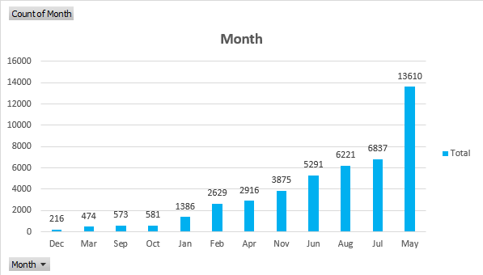
PART I : Univariate Analysis
Variable under consideration: Month
Majority of the Calls made During Month of May.

Slide 6
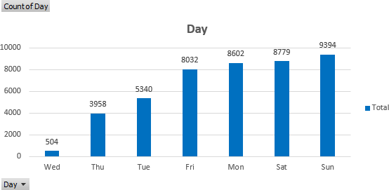
PART I : Univariate Analysis
Variables under consideration: Day
Majority of the Calls made during Weekends compared to weekdays Since Majority of the Customers from Working age Group.

Slide 7
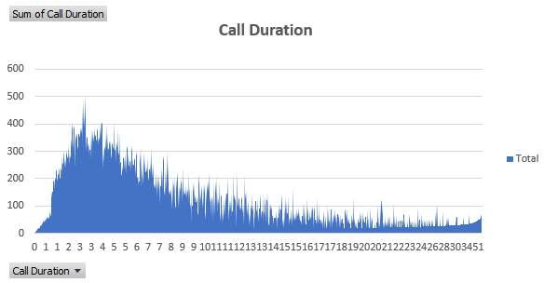
PART I : Univariate Analysis
Variables under consideration: Call Duration
Majority of the Customers Call Duration is between 1-3 Minutes.

Slide 8
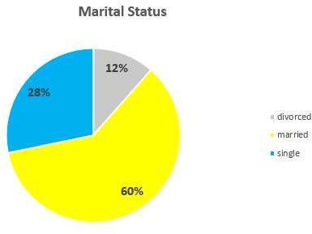
PART I : Segmented Univariate Analysis
Variables under consideration: Marital Status
Majority of the Customers are either Married or Single.

Slide 9
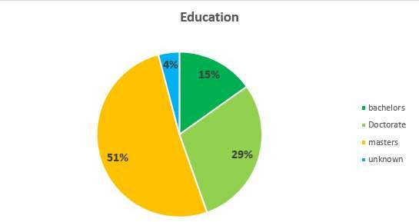
PART I : Segmented Univariate Analysis
Variables under consideration: Education
Majority of the Customers are holding either Masters or Doctorate degree.

Slide 10
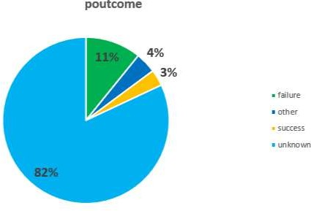
PART I : Segmented Univariate Analysis
Variables under consideration: Poutcome
Majority of the Customers i.e. 82% are not Reached previously.

Slide 11
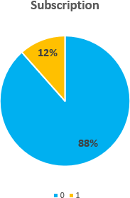
PART I : Segmented Univariate Analysis
Variables under consideration: Subscription
Majority of the Customers are Not Subscribed to term deposit i.e. 88%

Slide 12
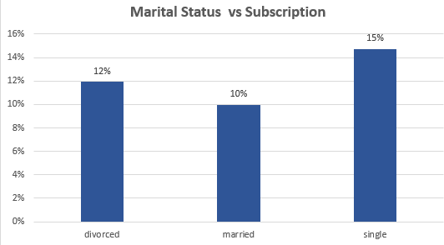
PART II : Bivariate Analysis
Variables under consideration: Marital Status vs Subscription
The Subscription Conversion rate of Single Customers is high i.e. 15% compared to divorced and married.

Slide 13
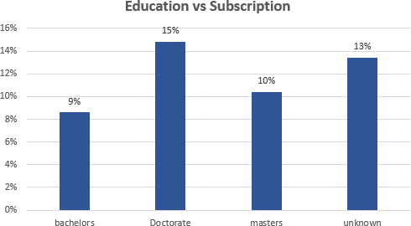
PART II : Bivariate Analysis
Variables under consideration: Education vs Subscription
The Subscription Conversion rate of Customers who are holding Doctorate degree is high i.e. 15% compared to Bachelors, Masters.

Slide 14
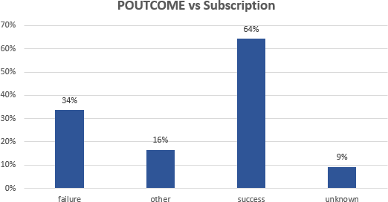
PART II : Bivariate Analysis
Variables under consideration: Poutcome vs Subscription
The Subscription Conversion rate of Customers whose Previous Outcome is Success is high i.e. 64%

Slide 15
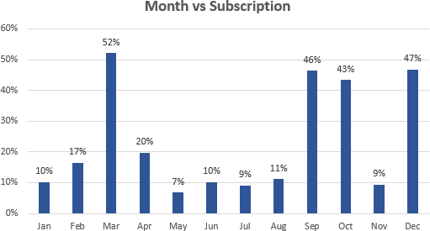
PART II : Bivariate Analysis
Variables under consideration: Month vs Subscription
The Subscription Conversion rate during month of March is high compared to other months. Since march is the end of the financial year
people are looking to invest in long term.

Slide 16
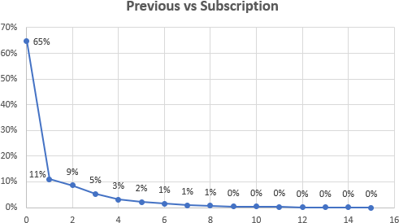
PART II : Bivariate Analysis
Variables under consideration: Previous vs Subscription
From the graph it is evident that as the number of Previous calls increases Subscription Conversion rate decreases.

Slide 17
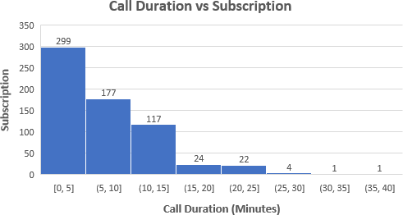
PART II : Bivariate Analysis
Variables under consideration: Call Duration vs Subscription
The Conversion rate of Call Duration less than 5 minutes is high.

Slide 18
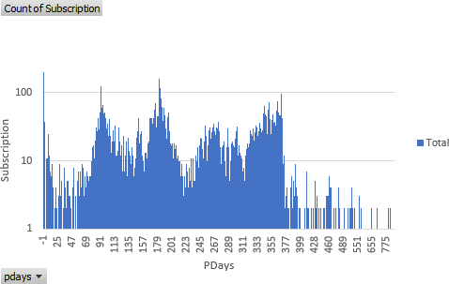
PART II : Bivariate Analysis
Variables under consideration: Pdays vs Subscription
Customers responded positively when reached out after an interval of quarterly or semi annually.

Slide 19
PART III: Major insights
It is Recommended to reach customers of age group 23-60 Years relatively More.
It is Recommended to reach customers from Blue-Collar and Management job categories relatively More.
It is Recommended to reach Doctorate Customers relatively More.
It is Recommended to reach Unmarried Customers i.e. Single relatively More.
It is Recommended to reach Customers during month of March relatively More.
It is Recommended not to reach Customers more than 8 calls.
It is Recommended to reach Customers who are already Subscribed relatively More.

